Slide 1
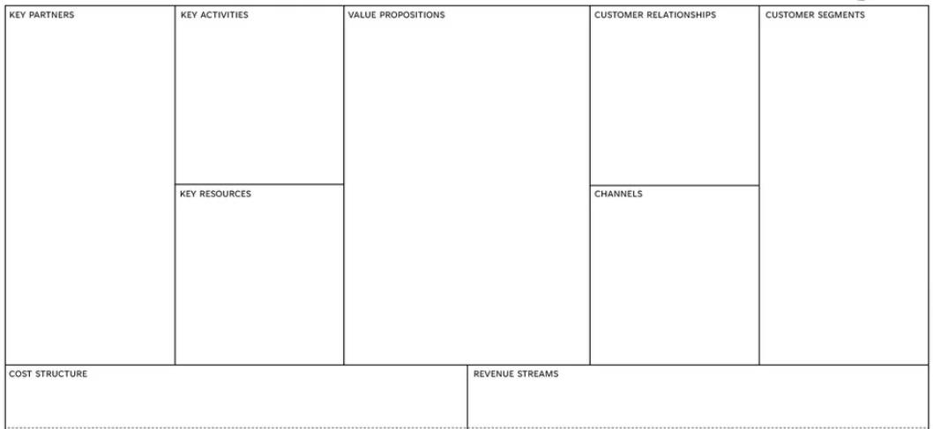
Our pearl bead and key chain are purchased through Shopee. So, Shopee is a big supplier. Besides that, Asia Pacific University (APU) provided a place for us to sell our product.
Before making the pearl beads, we did a survey form for APU students and outside students. After that, our member will gather to create the product by using pearl beads
Pre-order
-
People who love key chain and anime
Human resource
-APU
-Online

